Slide 1
The Influence of Pressure Force on Vibration and Muscle Activation
Presented By: Abdullah MOUSSELLI

Slide 2
Introduction
A research study conducted with OU-HSC
The goal of this study is to analyze the physical characteristics of vibration devices used for physical therapy.
This study consists of two parts mainly:
- study and analyze the effects of pressure force on the characteristics of vibration.
- monitor the muscle activity while applying different levels of pressure.

Slide 3

Environment Setup
Experiments in this study were conducted on the Myovolt3 vibration device elbow and wrist kit.
Three vibration modes:
- sinusoidal
- pulse
- continuous

Slide 4

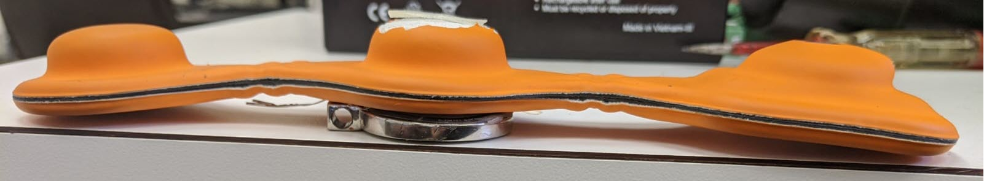
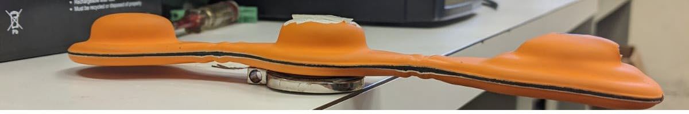
Environment Setup
Two testing environments :
- Pinned to table

Slide 5
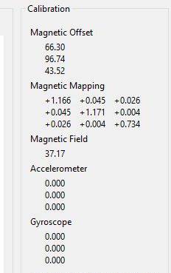
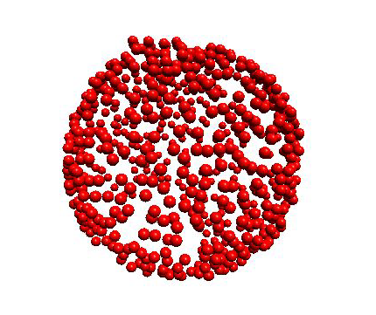

Environment Setup
LSM9DS1 9-DOF Accelerometer sensor calibration
- Accelerometer was set to the highest available sampling rate by adjusting the Linear acceleration sensor Control Register 6.

Slide 6
Pressure Sensors
Device | Force Range | Area of Sensing Diameter | Repeatability Error Rate | Linearity Error | Drift | Hysteresis
SingleTact | 2.2 lbs. (can go up to 5 lbs.) | 0.31 inch | <1.5% | <2.0% | 2% in 1 min, 4% in 10 min, at 50% FSR load | < 4.0%
FlexiForce (0.375”) | 0-25 lbs. (varies with the value of the Reference resistor) | 0.375 inch | <2.0% | <3.0% | < 5% per logarithmic time scale | < 4.5 %
FlexiForce (1”) | 0-25 lbs. (varies with the value of the Reference resistor) | 1 inch | <2.0% | <3.0% | < 5% per logarithmic time scale | < 4.5 %

Slide 7
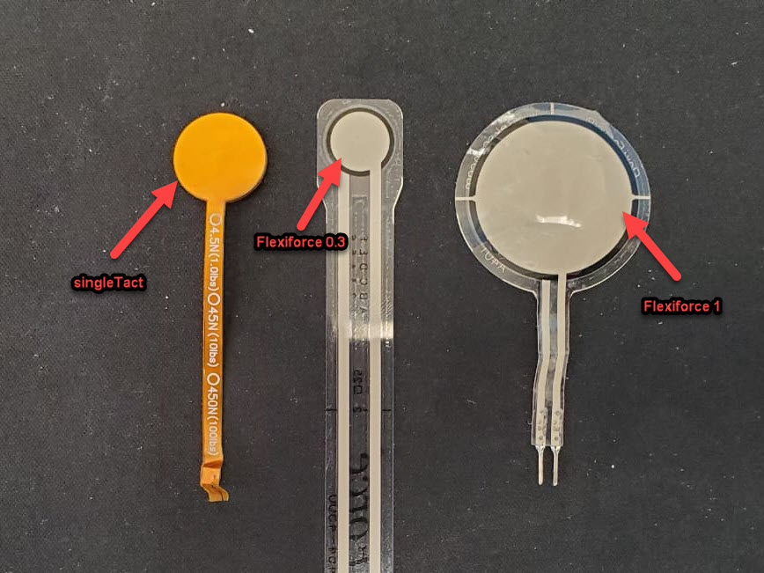
Pressure Sensors
Three pressure sensors were tested and compared:

Slide 8
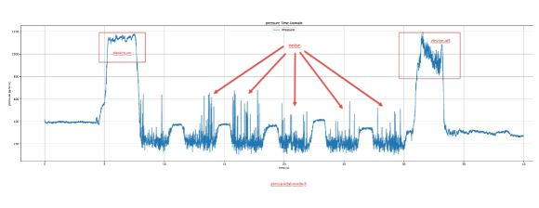
Observations and Findings
When applying pressure lesser than 400 gram-force a significant noise is measured specially for sinusoidal vibration mode

Slide 9
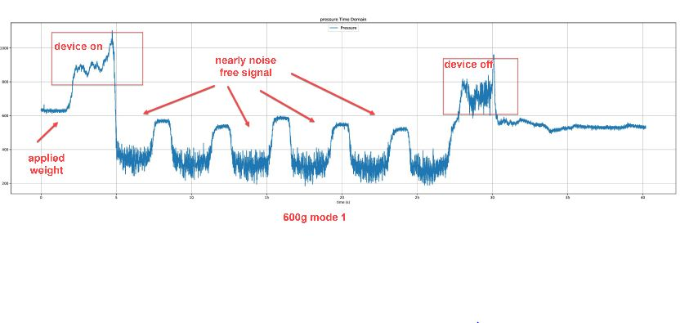
Observations and Findings
As the pressuring weight being applied increases (around 600 gram-force) , the signal became stable and nearly noise-free.

Slide 10
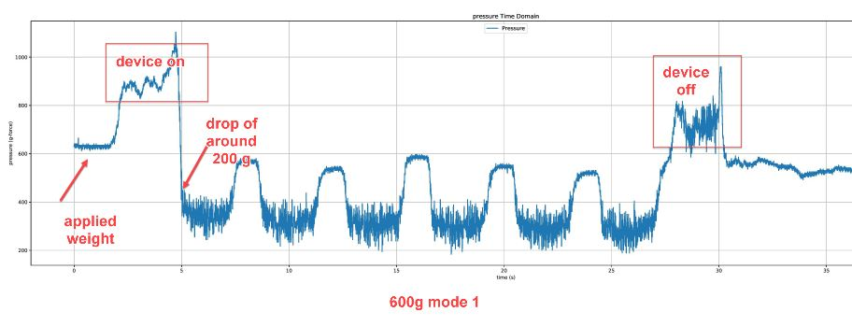
Observations and Findings
Pressure values are measured by 200g force less than actual when the vibrator is turned on. This was noted for pressure tested between 200 and 1,500g.

Slide 11
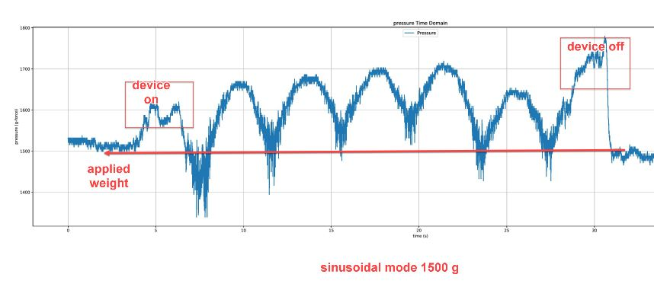
Observations and Findings
Above 1,500g force, pressures measurements were nearly matching initial pressure applied.

Slide 12
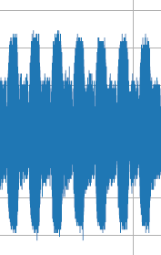
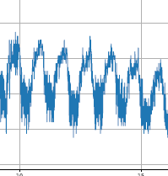
Observations and Findings
some resemblance between pressure signals and vibration mode was observed.
comparison between vibration signal and pressure sign al for 1500-gram force mode 2

Slide 13
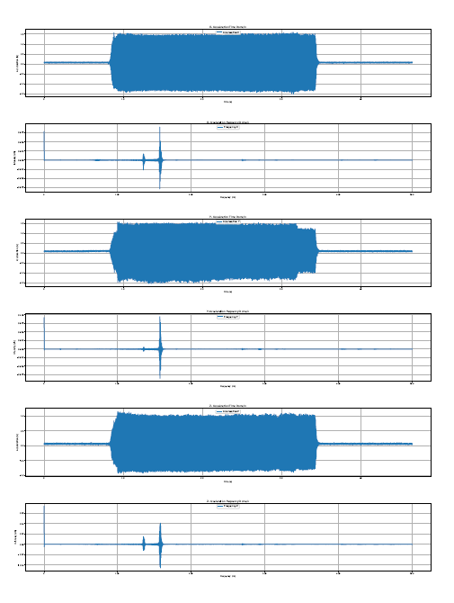
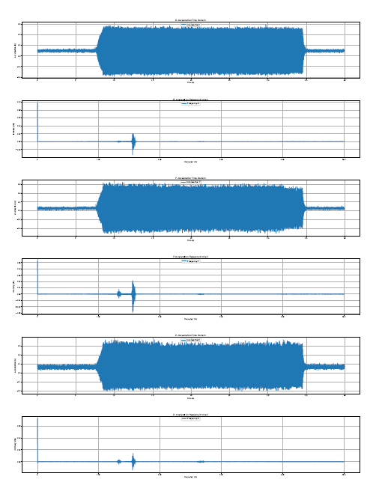
Observations and Findings
Amplitude of acceleration is reduced when applied pressures is increased.
Similar effect has been observed in frequency domain specially for mode 3
comparison between two vibration signals in frequency domain the left figure is 400g the right figure is 2000g mode 3

Slide 14
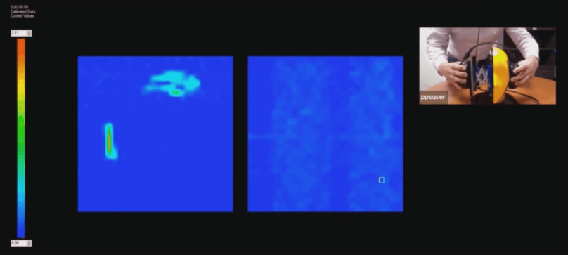
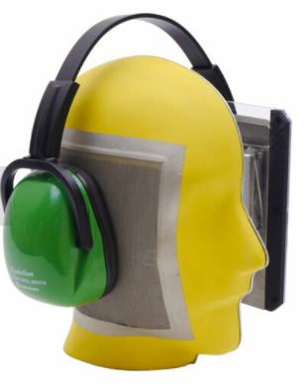
Environment Setup
Body Pressure mapping

Slide 15
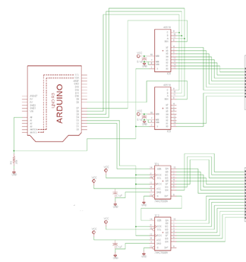


Environment Setup

Slide 16
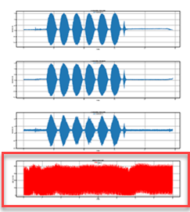
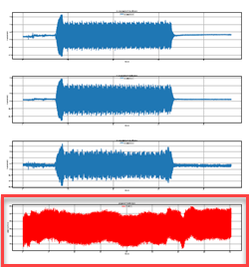
Device worn on body
Pressure signals were very noisy, and no matching response was detected to the vibrating signal. The red plot represents the pressure signal.
To further investigate this EMG readings were recorded and analyzed in both time and frequency domains.

Slide 17
Electromyography EMG
A technique for evaluating & recording the electrical activity produced by muscles.
Applications:
- Postural control.
- Physical therapy.
- Gesture detection.
- Fatigue detection.
Two types categorized by Electrode
Inserted (fine wire or needle)
Surface.

Slide 18
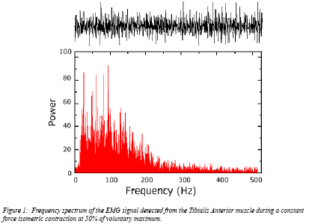
Characteristics of EMG signal
Amplitude range: 0–10 mV (+5 to -5) prior to amplification
Useable energy: Range of 0 - 500 Hz
Dominant energy: 50 – 150 Hz

Slide 19
General Concerns About EMG
Noise and distortion can be categorized as follows:
-Inherent noise in electronics equipment
-Ambient noise
-Motion artifact
-Inherent instability of signal
1-Inherent noise in electronics equipment: Frequency range: 0 – several thousand Hz depending on the device reduced by filtering and using high quality components
2-Ambient Noise: produced by electromagnetic radiation sources (electrical wires).Dominant frequency: 60 Hz. Amplitude: 1 – 3x EMG signal.
3- Motion artifact: two main sources; electrode/skin interface and electrode cables. Frequency range: 0-20 Hz can be eliminated with filtering.
4-Inherent instability of signal: Frequency range of 0 – 20 Hz is especially unstable can be eliminated with filtering.

Slide 20
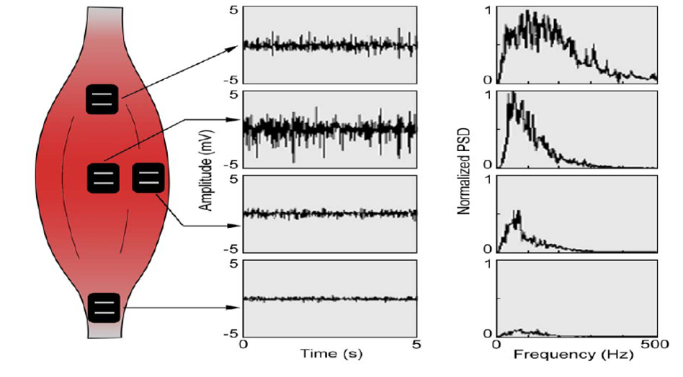
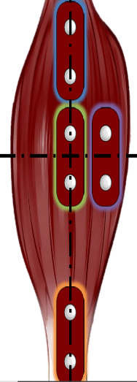
General Concerns About EMG
Electrodes placement
Away from tendon
Away from outer edge of muscle
Orientation parallel to muscle fibers

Slide 21
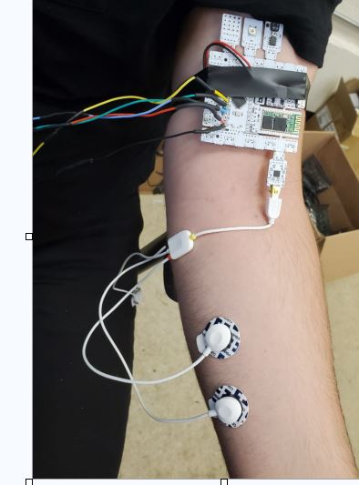
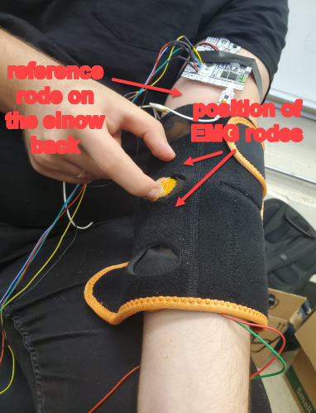
Environment Setup
Analysis performed on the vibration device strapped to left arm.

Slide 22
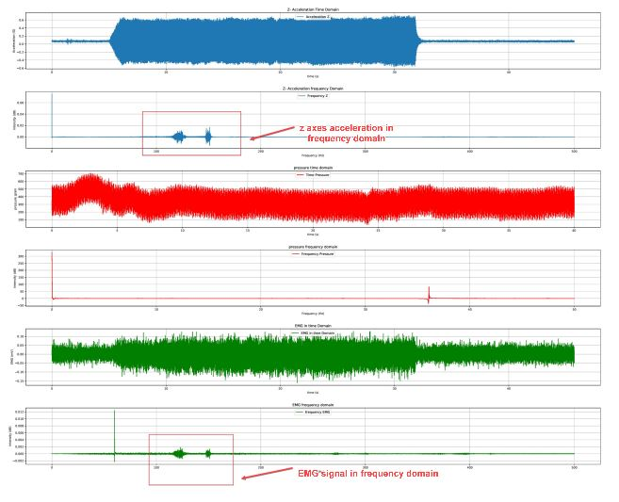
Observations and Findings
By analyzing the signals in frequency spectrum, we can determine more clearly how the muscle is responding to the vibration signal. It is observed that the EMG signal resembles the vibration signal emitted from the Myovolt3 for the three vibration modes.

Slide 23
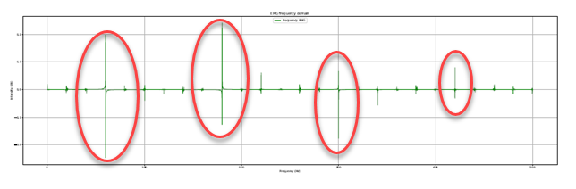
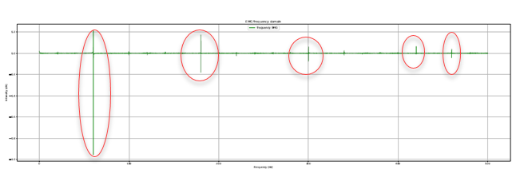
Analyzing The EMG Signal Noise In Frequency Spectrum
- Device off
- Sinusoidal mode

Slide 24
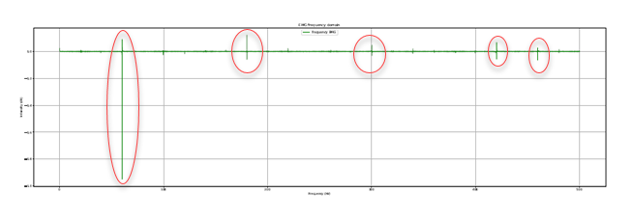
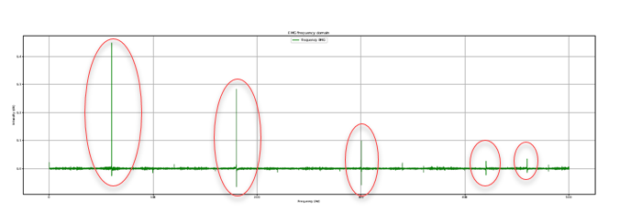
Analyzing The EMG Signal Noise In Frequency Spectrum
- Pulsing mode
- Continuous mode

Slide 25
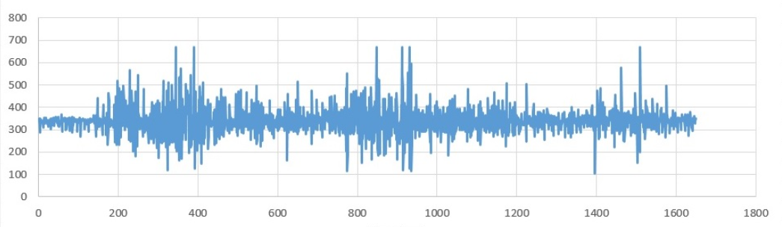
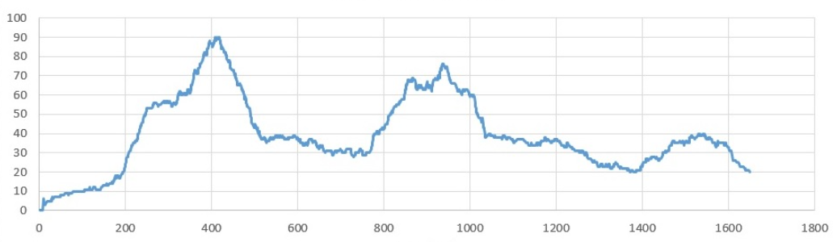
Reducing The EMG Signal Noise
Filter high frequency noise from signal, and subtract a reference signal from the actual signal
Filter low frequency noise from signal and normalize signal
Rectify the signal
Take a moving average of the signal
Raw EMG (time over frequency)
Filtered EMG signal

Slide 26
Thank you ☺

